Slide 1


ECMAScript 6
& TypeScript
-- PART 1 --
copyright 2016 Trainologic LTD

Slide 2

ECMAScript 6 & TypeScript
Intro
Intro
Block Scoped Variables
Arrow Functions
Rest Parameters
Template Strings
Default Parameters
Computed Property Names
Destructuring Assignment
for...of
copyright 2016 Trainologic LTD

Slide 3

ECMAScript 6 & TypeScript
About This Part
Focuses on ES6 specific features
That is: features that exist in ECMAScript 2015
These features provide extended capabilities
When the TS compiler target option is set to “es5” (*), TS code is transpiled into standard ES5 JS
* (this is what we want until ES6 is fully supported)
3
copyright 2016 Trainologic LTD

Slide 4
ECMAScript 6 & TypeScript
ECMA Who?
ECMAScript (or ES)
  A trademarked scripting language specification
  Owned by ECMA International
ECMA International
  European Computer Manufacturers Association
  A private, non-profit international standards organization
  Develop standards & reports to facilitate and standardize the use of information communication technology and consumer electronics
  Members: Adobe, HP, Google, IBM, PayPal, MS, Intel, Hitachi, …
Spec implementations include:
  JavaScript
  ActionScript (Macromedia)
  JScript (Microsoft)
3
copyright 2016 Trainologic LTD

Slide 5
ECMAScript 6 & TypeScript
ECMAScript – Bit of History
1995: Mocha (JavaScript’s original name) developed at Netscape
  Developed in only 10 days. Interestingly, they soon after also
  released a server-side scripting version
1996: JS taken to ECMA for standartization
1997: ECMAScript standard edition 1 released
1998: edition 2, ISO alignments (no new features)
1999: edition 3, introducing regex, better string handling, new control statements, try/catch ex. handling and more.
In-between: Edition 4 dropped due to political differences
2009: edition 5, introducing “strict mode”, JSON support, object properties reflection and more.
2011: edition 5.1, ISO-3 alignments (no new features)
2015: edition 6, a.k.a. ES6 / ECMAScript 2015 / ES6 Harmony
June 2016: edition 7, with only two features: exponentiation operator (**) and Array.prototype.includes
3
copyright 2016 Trainologic LTD

Slide 6
ECMAScript 6 & TypeScript
ES7 – Why So Small?
ES7 / ECMAScript 2016 is so small due to the new release process, which is actually good
New features are only included after they are completely ready and after there were at least two implementations that were sufficiently field-tested.
Releases will now happen much more frequently (once a year) and will be more incremental
3
copyright 2016 Trainologic LTD

Slide 7
ECMAScript 6 & TypeScript
Atwood’s Law
“Any application that can be written in JavaScript will eventually be written in JavaScript”
3
copyright 2016 Trainologic LTD

Slide 8

ECMAScript 6 & TypeScript
Note about Sloppy Mode
In this presentation you might see mentions of the term “Sloppy Mode”
This is a common (but unofficial) term referring to the normal, non-strict mode of JavaScript
3
copyright 2016 Trainologic LTD

Slide 9
ECMAScript 6 & TypeScript
Intro
Classes & Packages.
Arrow Functions
Rest Parameters
Template Strings
Default Parameters
Computed Property Names
Destructuring Assignment
for...of
Block Scoped Variables
copyright 2016 Trainologic LTD

Slide 10
ECMAScript 6 & TypeScript
var’s Function Scope
One of the common complaints has been JavaScript’s lack of block scope
Unlike other popular languages (C/Java/…), blocks ({...}) in JavaScript (pre-ES6) do not have a scope
Variables in JavaScript are scoped to their nearest parent function, or globally if there is no function present
copyright 2016 Trainologic LTD

Slide 11

ECMAScript 6 & TypeScript
Why No Block Scope?
JavaScript was created in 10 days in May 1995 by Brendan Eich, then working at Netscape
When asked why JavaScript does not have block scopes, Brendan replied:
There wasn’t enough time
copyright 2016 Trainologic LTD

Slide 12
ECMAScript 6 & TypeScript
var Challenges
  Scoping is confusing for developers coming from other languages
  Local vs. Global confusion, accidental shadowing
  Confusing workaround patterns: IIFE
  Misconceptions about hoisting
function blocky() {
if (!hoisty) {
var hoisty = “gotcha";
}
alert(hoisty); // alerts “gotcha" instead of reference error
}
blocky();
copyright 2016 Trainologic LTD

Slide 13
ECMAScript 6 & TypeScript
The let Statement
Using “let” instead (ECMAScript 6) is more intuitive
let Syntax (similar to “var”):
let var1 [= value1] [, var2 [= value2]] [, ..., varN [= valueN]];
function blocky() {
if (!hoisty) {
let hoisty = “gotcha";
}
alert(hoisty); // reference error: hoisty is not defined
}
blocky();
3
copyright 2016 Trainologic LTD

Slide 14
ECMAScript 6 & TypeScript
let Semantics
The new ES6 keyword let allows scoping variables at the block level (the nearest curly brackets)
limited in scope to the block, statement, or expression on which it is used
var fruit = “guava”;
if (true) {
let fruit = “mango”;
console.log(fruit); // mango
}
console.log(fruit); // guava
var listItems = document.querySelectorAll(‘li’);
for (let i = 0; i < listItems.length; i++) {
let element = listItems[i];
element.addEventListenet(‘click’, function() {
alert(‘Clicked item number ‘ + i);
});
}
3
copyright 2016 Trainologic LTD

Slide 15
ECMAScript 6 & TypeScript
let Limitations
Cannot be re-declared in same block scope
  SyntaxError: Identifier … has already been declared
  Also applies in switch-case blocks
  Also applies to using var x after let x statement
  Can’t shadow function argument names
let variables cannot be referenced before their declaration
  The variable is hoisted to top of block
  however it is in “temporal dead zone” and cannot be accessed
  Will result in ReferenceError
3
copyright 2016 Trainologic LTD

Slide 16
ECMAScript 6 & TypeScript
var vs. let
var x = ‘global’;
let y = ‘not global’;
console.log(this.x); // “global”
console.log(this.y); // undefined
3
copyright 2016 Trainologic LTD

Slide 17
ECMAScript 6 & TypeScript
Block Scopes & TS - let
TS transpiles let to var declarations
Renames variable name if it already exists in surrounding scope
// fooya.ts
var foo = ‘fooya!’;
If (true) {
let foo = ‘nununu!’;
}
console.log(foo); // fooya
// fooya.js
var foo = ‘fooya!’;
If (true) {
var foo_1 = ‘nununu!’;
}
console.log(foo); // fooya
3
copyright 2016 Trainologic LTD

Slide 18
ECMAScript 6 & TypeScript
Block Scopes & TS – let cont.
TS transpiles let to var in for loops too
For simple loops, TS ends it there
// loopy.ts
for (let i = 0; I < 5; i++) {
console.log(i);
}
// loopy.js
for (var i = 0; I < 5; i++) {
console.log(i);
}
copyright 2016 Trainologic LTD

Slide 19
ECMAScript 6 & TypeScript
Block Scopes & TS – let cont.
When closures in for loops are detected however, TS will extract the call out to a separate function
// closure.ts
var funcs = [];
for (let i = 0; I < 5; i++) {
funcs.push(function() {
console.log(i);
});
}
// closure.js
var funcs = [];
var _loop_1 = function(i) {
funcs.push(function() {
console.log(i);
});
};
for (var i = 0; I < 5; i++) {
_loop_1(i);
}
copyright 2016 Trainologic LTD

Slide 20
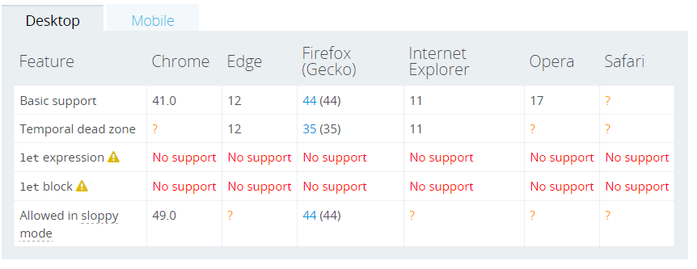
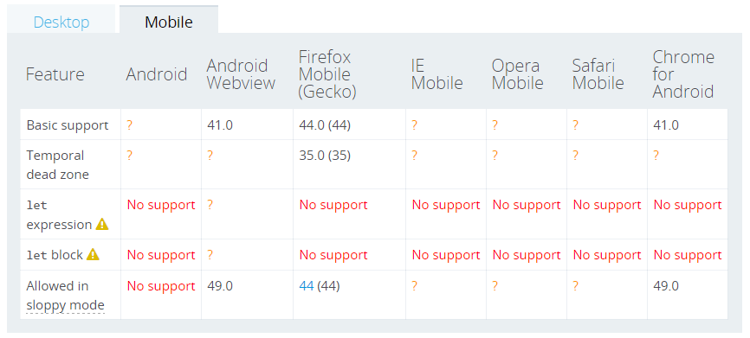
ECMAScript 6 & TypeScript
Browser Compatibility - let
copyright 2016 Trainologic LTD

Slide 21
ECMAScript 6 & TypeScript
const
Syntax:
const name1 = value1 [, name2 = value2 [, ... [, nameN = valueN]]];
Creates a read-only reference to a value
Doesn’t mean the value is immutable; only the variable identifier can’t be reassigned
Constant declarations must be initialized
Constants are block-scoped, similar to let variables
Constants values cannot be re-assigned nor re-declared
All “temporal dead zone” considerations applying to “let” apply here too
copyright 2016 Trainologic LTD

Slide 22
ECMAScript 6 & TypeScript
const – Examples
const PI = 3.141592;
const API_KEY = ‘super*secret*123’;
const HEROES = [];
HEROES.push(‘Jon Snow’); // okay
HEROES.push(‘Tyrian Lannister’); // okay
HEROES = [‘Ramsay Bolton’, ‘Walder Frey’]; // error
copyright 2016 Trainologic LTD

Slide 23
ECMAScript 6 & TypeScript
Block Scopes & TS - const
TS simply transpiles const to var declarations
// constantin.ts
const c = 84;
function funk() {
const c = 42;
}
// constantin.js
var c = 84;
function funk{
var c = 42;
}
copyright 2016 Trainologic LTD

Slide 24
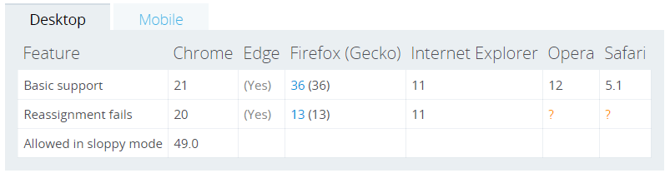
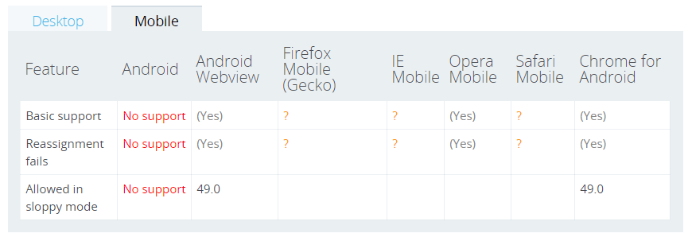
ECMAScript 6 & TypeScript
Browser Compatibility - const
copyright 2016 Trainologic LTD

Slide 25
ECMAScript 6 & TypeScript
When Do We Use Which?
One recommendation:
  Use const by default
  Use let if you have to rebind a variable
  Use var to signal untouched legacy code
But other opinions exist:
  Use var to signal variables used throughout the function (i.e. function scope)
copyright 2016 Trainologic LTD

Slide 26
ECMAScript 6 & TypeScript
Intro
Block Scoped Variables
Arrow Functions
Rest Parameters
Template Strings
Default Parameters
Computed Property Names
Destructuring Assignment
for...of
Arrow Functions
copyright 2016 Trainologic LTD

Slide 27
ECMAScript 6 & TypeScript
Arrow Functions
A.k.a. “Fat Arrow” (because -> is a thin arrow and => is a fat arrow)
A.k.a. “Lambda Function” (because of other languages)
Promotes the functional programming paradigm in JS
Addresses a JS pain-point of losing the meaning of this
Motivation:
  No need to keep typing function
  Lexically captures this from the surrounding context
  Lexically captures arguments of a function
copyright 2016 Trainologic LTD

Slide 28
ECMAScript 6 & TypeScript
Basic Syntax
(param1, param2, …, paramN) => { statements }
(param1, param2, …, paramN) => expression
// equivalent to: => { return expression; }
// Parentheses are optional with a single parameter:
(singleParam) => { statements }
singleParam => { statements }
// A function with no parameters requires parentheses:
() => { statements }
copyright 2016 Trainologic LTD

Slide 29
ECMAScript 6 & TypeScript
Examples
var f_1 = (x) => x + 1; // increment by 1
let f_2 = x => 2 * x; // muiply by 2
// zero arguments requires using parentheses
const f_3 = () => console.log(‘look ma, no arguments’);
// as anonymous timer callback
setTimeout(() => { console.log('well, it is about time'); }, 1000);
copyright 2016 Trainologic LTD

Slide 30
ECMAScript 6 & TypeScript
Advanced Syntax
// Parenthesize the body to return an object literal expression
params => ({foo: bar})
// Rest parameters and default parameter values
(param1, param2, ...rest) => { statements }
(param1 = defaultValue1, param2, …, paramN = defaultValueN) => { statements }
// Destructuring within the parameter list
var f = ([a, b] = [1, 2], {x: c} = {x: a + b}) => a + b + c;
f(); // 6
copyright 2016 Trainologic LTD

Slide 31
ECMAScript 6 & TypeScript
The Lexical this
Until arrow functions, every new function defined its own this value:
  Constructor: new object
  Strict Mode: undefined
  “Object Method”: the context object
We had to use a capture variable to keep hold of this
copyright 2016 Trainologic LTD

Slide 32

ECMAScript 6 & TypeScript
Using a Capture Variable
That can become very annoying, especially with OOP
// annoying.js
function QuoteMaster() {
var self = this;
this.quote = ‘if only we had arrow functions’;
this.sayIt = function() {
console.log(self.quote);
};
setTimeout(this.sayIt, 1000);
}
copyright 2016 Trainologic LTD

Slide 33

ECMAScript 6 & TypeScript
Using an Arrow Function
The this reference is captured from outside the function body
// relaxing.js
function QuoteMaster() {
this.quote = ‘luckily we have arrow functions’;
this.sayIt = () => console.log(this.quote);
setTimeout(this.sayIt, 1000);
}
copyright 2016 Trainologic LTD

Slide 34
ECMAScript 6 & TypeScript
Arrow Functions & TS
Behind the scenes TS generates a capture variable
// relaxing.ts
function QuoteMaster() {
this.quote = ‘fat arrow rulez’;
this.sayIt = () =>
console.log(this.quote);
setTimeout(this.sayIt, 1000);
}
// relaxing.js
function QuoteMaster() {
var _this = this; // capture variable
this.quote = ‘fat arrow rulez';
this.sayIt = function () {
return console.log(_this.quote);
};
setTimeout(this.sayIt, 1000);
}
copyright 2016 Trainologic LTD

Slide 35
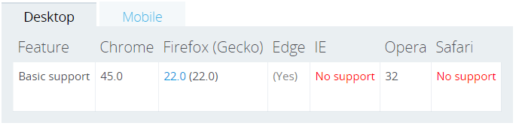
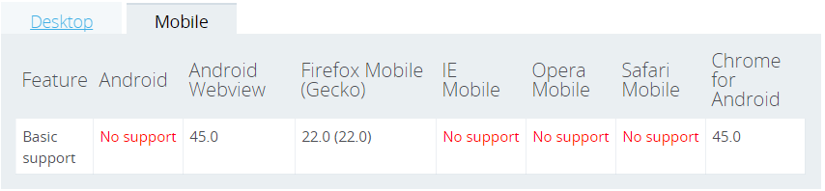
ECMAScript 6 & TypeScript
Browser Compatibility – Arrow Function
copyright 2016 Trainologic LTD

Slide 36
ECMAScript 6 & TypeScript
Intro
Block Scoped Variables
Arrow Functions
String Templates
Template Strings
Default Parameters
Computed Property Names
Destructuring Assignment
for...of
Rest Parameters
copyright 2016 Trainologic LTD

Slide 37
ECMAScript 6 & TypeScript
Rest Parameters
Convenient way to accept multiple parameters as array
Denoted by ...restArgsName as the last argument
The ellipsis notation (…) is a new spread operator
Reduce boilerplate code induced by the arguments
Can be used in any function (plain function / fat arrow)
Syntax:
function(a, b, ...allTheRest) { // … }
Spread operator
copyright 2016 Trainologic LTD

Slide 38
ECMAScript 6 & TypeScript
Rest Parameters
Differences between rest parameters and arguments object:
 | Rest Parameters | arguments Object
Parameters received | Only those not given separate name | All arguments passed to the function
Is Array? | A real array (supports sort, map, forEach, pop) | Not a real array
Special Properties | None | Has specific functionality, e.g. callee
copyright 2016 Trainologic LTD

Slide 39
ECMAScript 6 & TypeScript
Example – Rest Parameters
function getTheOthers(first, second, ...allOthers) {
console.log(allOthers);
}
// [] empty array since first two args are named (“first”, “second”)
getTheOthers('Cersei Lannister', 'Daenerys Targaryen');
// ['Khal Drogo', 'Roose Bolton', 'Robert Baratheon']
getTheOthers('Cersei Lannister', 'Daenerys Targaryen',
'Khal Drogo', 'Roose Bolton', 'Robert Baratheon');
copyright 2016 Trainologic LTD

Slide 40
ECMAScript 6 & TypeScript
Rest Parameters & TS
  // reverts to using the arguments object
  function getTheOthers(first, second) {
  var allOthers = [];
  for (var _i = 2; _i < arguments.length; _i++) {
  allOthers[_i - 2] = arguments[_i];
  }
  console.log(allOthers);
  }
  // [] empty array since first two args are named (“first”, “second”)
  getTheOthers('Cersei Lannister', 'Daenerys Targaryen');
  // ['Khal Drogo', 'Roose Bolton', 'Robert Baratheon']
  getTheOthers('Cersei Lannister', 'Daenerys Targaryen',
  'Khal Drogo', 'Roose Bolton', 'Robert Baratheon');
copyright 2016 Trainologic LTD

Slide 41
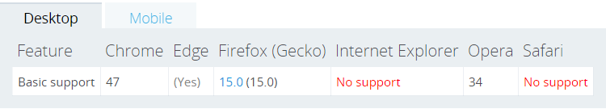
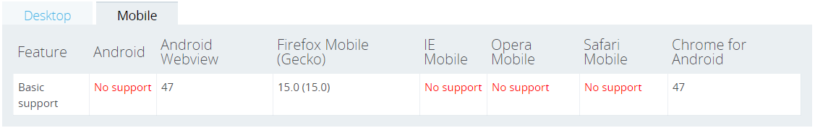
ECMAScript 6 & TypeScript
Browser Compatibility - Rest Parameters
copyright 2016 Trainologic LTD

Slide 42
ECMAScript 6 & TypeScript
Intro
Block Scoped Variables
Arrow Functions
Rest Parameters
Rest Parameters
Default Parameters
Computed Property Names
Destructuring Assignment
for...of
Template Strings
copyright 2016 Trainologic LTD

Slide 43
ECMAScript 6 & TypeScript
Template Strings (also: String Literals)
Syntactically these are strings that use backticks
`
Motivation:
  Multiline strings
  String interpolation (i.e. parameterized)
  Tagged templates
This is a backtick right here
copyright 2016 Trainologic LTD

Slide 44
ECMAScript 6 & TypeScript
Template Strings – cont.
Mutiline Strings
  Allows us to easily create a string spanning multiple lines
String Interpolation
  Allow us to create string templates with placeholders
  Placeholder expressions are evaluated into the resulting string
Tagged Templates
  Allow us to place a function (called a tag) before the template string
  The tag function gets the opportunity to pre-process the template string literals and placeholder expressions
  Can be used for example for escaping the string
copyright 2016 Trainologic LTD

Slide 45
ECMAScript 6 & TypeScript
Template Strings – Syntax
`string text` // simple string literal
`string text line 1
string text line 2` // multiline string literal
`string text ${expression} string text` // interpolation literal
tag `string text ${expression} string text` // tagged template
copyright 2016 Trainologic LTD

Slide 46
ECMAScript 6 & TypeScript
Examples – Multiline & Interpolation
// multiline
var debugLyrics = `Catch, catch, catch a bug.
Put it in a jar.
Sometimes they fly, sometimes they die,
but most get squashed on your car.`;
// interpolation
let htmlString = `<div class=“song”>${debugLyrics}</div>`;
// hack, we can practically interpolate any expression
const theAnswer = `2 times 21 make ${2 * 21}`;
copyright 2016 Trainologic LTD

Slide 47
ECMAScript 6 & TypeScript
Example – Tagged Template
var animal = "dog";
var result = myTagFunc `${animal}s are the best!`;
function myTagFunc(literals, ...values) { // a sample tag function
let result = "";
for (let i = 0; i < values.length; i++) { // interleave the literals with the values
result += literals[i];
result += values[i] === animal ? 'literal string' : values[i]; // replace dawg
}
result += literals[literals.length - 1]; // add the last literal
return result;
}
console.log(result); // literal strings are the best!
copyright 2016 Trainologic LTD

Slide 48
ECMAScript 6 & TypeScript
Template Strings & TS
TS transpiles multiline strings → escaped strings
TS transpiles string interpolations → string concatenations
var debugLyrics = "Catch, catch, catch a bug.\u00A0\v\nPut it in a jar.\u00A0\v\nSometimes they fly, \nsometimes they die,\u00A0\n\vbut most get squashed on your car.";
var theAnswer = "2 times 21 make " + 2 * 21;
copyright 2016 Trainologic LTD

Slide 49
ECMAScript 6 & TypeScript
Template Strings & TS
TS transpiles tagged templates → function calls
var animal = "dog";
var result = (_a = ["", "s are the best!"], _a.raw = ["", "s are the best!"], myTagFunc(_a, animal));
function myTagFunc(literals) { // a sample tag function
var values = [];
for (var _i = 1; _i < arguments.length; _i++) {
values[_i - 1] = arguments[_i];
}
var result = "";
for (var i = 0; i < values.length; i++) { // interleave the literals with the values
result += literals[i];
result += values[i] === animal ? 'literal string' : values[i]; // replace dawg
}
result += literals[literals.length - 1]; // add the last literal
return result;
}
console.log(result); // literal strings are the best!
var _a;
copyright 2016 Trainologic LTD

Slide 50
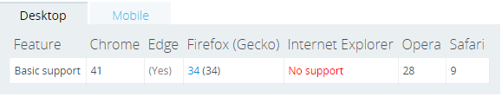

ECMAScript 6 & TypeScript
Browser Compatibility – Template Strings
copyright 2016 Trainologic LTD

Slide 51
ECMAScript 6 & TypeScript
Intro
Block Scoped Variables
Arrow Functions
Rest Parameters
Template Strings
Default Parameters
Computed Property Names
Destructuring Assignment
for...of
Default Parameters
copyright 2016 Trainologic LTD

Slide 52
ECMAScript 6 & TypeScript
Default Parameters
In JavaScript, parameters of functions default to undefined
It is useful in some situations to set different defaults
Default function parameters allow formal parameters to be initialized with default values if no value or undefined is passed
Syntax:
function [name]([param1[ = defaultValue1 ]
[, ..., paramN[ = defaultValueN ]]])
{ statements }
copyright 2016 Trainologic LTD

Slide 53
ECMAScript 6 & TypeScript
Default Parameters – cont.
Replaces the common strategy of testing values in function body:
function multiply(a, b) {
var b = b !== undefined ? b : 1; // yuck!
…
Instead we can more elegantly write:
function multiply(a, b = 1) {
copyright 2016 Trainologic LTD

Slide 54
ECMAScript 6 & TypeScript
Default Parameters – Example
  function sendRaven(to, body, subject = 'New Raven Mail') {
  console.log(`Sending mail with subject "${subject}"`);
  }
  var recipients = ['Lord Commander<lord.commander@castleblack.org',
  'Maester<maester@castleblack.org'];
  // Sending mail with subject "New Raven Mail"
  sendRaven(recipients, "The winter is coming");
  // Sending mail with subject "New Raven Mail"
  sendRaven(recipients, "The winter is coming", undefined);
  // Sending mail with subject “Winter Sale!"
  sendRaven(recipients, "The winter is coming", “Winter Sale!");
copyright 2016 Trainologic LTD

Slide 55
ECMAScript 6 & TypeScript
Default Parameters – cont.
Default parameters are available to consequent default parameters
  function runWeirdCalc(a, b, c = 42, d = c / 2) {
  console.log(`Calculation yields: ${a * b + c + d} (${a} * ${b} + ${c} + ${d})`;
  }
  runWeirdCalc(); // Calculation yields: NaN (undefined * undefined + 42 + 21)
  runWeirdCalc(1); // Calculation yields: NaN (1 * undefined + 42 + 21)
  runWeirdCalc(1, 2); // Calculation yields: 65 (1 * 2 + 42 + 21)
  runWeirdCalc(1, 2, 3); // Calculation yields: 6.5 (1 * 2 + 3 + 1.5)
  runWeirdCalc(1, 2, 3, 4); // Calculation yields: 9 (1 * 2 + 3 + 4)
copyright 2016 Trainologic LTD

Slide 56
ECMAScript 6 & TypeScript
Default Parameters – cont.
Default parameters can even accept other default values, such as function calls, this and the arguments object
  function getD() {
  return "You got Dee!"
  }
  function checkThisOut(a, b = 5, c = b, d = getD(), e = this,
  f = arguments, g = this.whatsThis) {
  return [a,b,c,d,e,f,g];
  }
  // ["Whoa", 5, 5, "You got Dee!", Window, Arguments[1], undefined]
  // (Note: Arguments only contains “Whoa”)
  console.log(checkThisOut("Whoa"));
copyright 2016 Trainologic LTD

Slide 57
ECMAScript 6 & TypeScript
Default Parameters – cont.
As opposed to other languages (C# et al.), defaults can be provided to any parameter(s), not necessarily consecutive or in any particular order
  function func (a = 42, b, c = a, d, e = “Cool”) {
  return [a,b,c,d,e];
  }
  console.log(func(undefined, 15, “Yeah”)); // [42, 15, "Yeah", undefined, "Cool"]
copyright 2016 Trainologic LTD

Slide 58
ECMAScript 6 & TypeScript
Default Parameters – cont.
Destructured parameter with default value assignment
  function func([x, y] = [1, 2], {z: z} = {z: 3}) {
  return x + y + z;
  }
  func(); // 6
copyright 2016 Trainologic LTD

Slide 59
ECMAScript 6 & TypeScript
Default Parameters & TS
TypeScript transpiles to code which sets defaults in case the argument value is undefined
(it uses the void operator to obtain the undefined primitive)
  function sendRaven(to, body, subject) {
  if (subject === void 0) { subject = 'New Raven Mail'; }
  console.log("Sending mail with subject \"" + subject + "\"");
  }
  function runWeirdCalc(a, b, c, d) {
  if (c === void 0) { c = 42; }
  if (d === void 0) { d = c / 2; }
  console.log("Weird calculation yields: " + (a * b + c + d) +
  " (" + a + " * " + b + " + " + c + " + " + d + ")");
copyright 2016 Trainologic LTD

Slide 60
ECMAScript 6 & TypeScript
Default Parameters & TS – cont.
  function checkThisOut(a, b, c, d, e, f, g) {
  if (b === void 0) { b = 5; }
  if (c === void 0) { c = b; }
  if (d === void 0) { d = getD(); }
  if (e === void 0) { e = this; }
  if (f === void 0) { f = arguments; }
  if (g === void 0) { g = this.whatsThis; }
  return [a, b, c, d, e, f, g];
  }
copyright 2016 Trainologic LTD

Slide 61
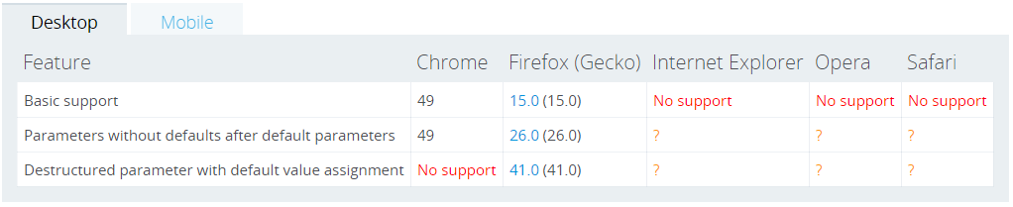
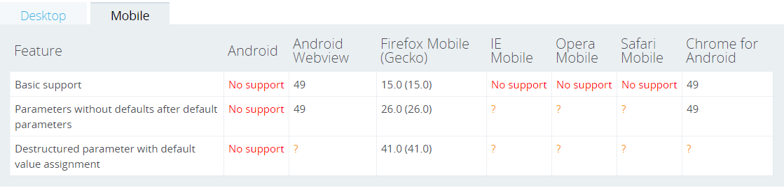
ECMAScript 6 & TypeScript
Browser Compatibility – Default Parameters
copyright 2016 Trainologic LTD

Slide 62
ECMAScript 6 & TypeScript
Intro
Block Scoped Variables
Arrow Functions
Rest Parameters
Template Strings
Default Parameters
Computed Properties
Destructuring Assignment
for...of
Computed Property Names
copyright 2016 Trainologic LTD

Slide 63
ECMAScript 6 & TypeScript
Computed Property Names
ES6 introduces the ability to define object property names based on computed keys
Syntax:
obj[{computed_expression}] = {value}
// usage in object literals
obj = {
[{computed_expression}]: {value}
};
copyright 2016 Trainologic LTD

Slide 64
ECMAScript 6 & TypeScript
Examples
  var x = 100, y = "abc";
  function getPropName() {
  return ++x;
  }
  //
  // object literal
  //
  var literal = {
  ["prop_" + getPropName()]: "Example 1",
  ["prop_" + y]: "Example 2"
  };
  console.log(literal); // {prop_101: "Example 1", prop_abc: "Example 2"}
  //
  // create a new computed property name (member) on the function object
  //
  getPropName["static_" + getPropName()] = y;
  console.log(getPropName.static_102); // abc
copyright 2016 Trainologic LTD

Slide 65
ECMAScript 6 & TypeScript
Computed Property Names & TS
Computed literal property names are transpiled into separate expressions, one per property
  var x = 100;
  var y = "abc";
  function getPropName() {
  return ++x;
  }
  var literal = (_a = {}, // new empty object is constructed
  _a["prop_" + getPropName()] = "Example 1", // computer property 1
  _a["prop_" + y] = "Example 2", // computer property 2
  _a // final statement returns the object
  );
  console.log(literal);
  getPropName["static_" + getPropName()] = y; // no special handling for this case
  console.log(getPropName.static_102);
  var _a; // object reference variable is declared as _a
copyright 2016 Trainologic LTD

Slide 66
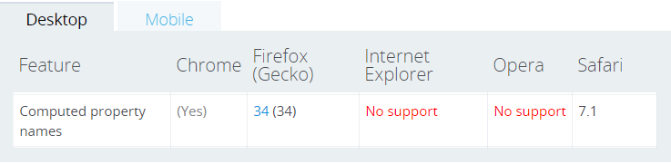
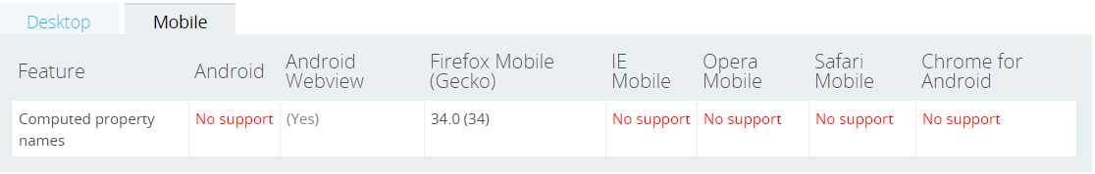
ECMAScript 6 & TypeScript
Browser Compatibility – Dynamic Property Names
copyright 2016 Trainologic LTD

Slide 67
ECMAScript 6 & TypeScript
Intro
Block Scoped Variables
Arrow Functions
Rest Parameters
Template Strings
Default Parameters
Computed Properties
Destructuring Assignment
for...of
Destructuring Assignment
copyright 2016 Trainologic LTD

Slide 68
ECMAScript 6 & TypeScript
Destructuring Assignment
De-structuring literally means breaking up a structure
Expressions that extract array/object data → distinct variables
Two destructuring types are supported: Array and Object
Syntax:
// array destructuring assignment
[a, b] = [1, 2]; // a=1, b=2
[a, b, ...rest] = [1, 2, 3, 4, 5] // a=1, b=2, rest= [3,4,5]
// object destructuring assignment
({a, b} = {a:1, b:2}) // a=1, b=2
({a, b, ...rest} = {a:1, b:2, c:3, d:4}); // a=1, b=2, rest=[3,4]
copyright 2016 Trainologic LTD

Slide 69
ECMAScript 6 & TypeScript
Examples – Object Destructuring
  var lastEpisode = { season: 6, episode: 10, title: "The Winds of Winter", aired: "2016-06-26" };
  // dstructuring assignment of all properties
  //
  var {season, episode, title, aired} = lastEpisode;
  console.log(season, episode, title, aired); // 6, 10, "The Winds of Winter", "2016-06-26“
  // dstructuring assignment of only few properties
  //
  var {title, aired} = lastEpisode;
  console.log(title, aired); // "The Winds of Winter", "2016-06-26“
  // assign extracted variable to new variable name
  //
  var {title, "aired": releaseDate} = lastEpisode;
  console.log(releaseDate); // "2016-06-26“
copyright 2016 Trainologic LTD

Slide 70
ECMAScript 6 & TypeScript
Examples – Deep Object Destructuring
  // create an object with nested properties
  var lastEpisodeWithInfo = {
  season: 6, episode: 10, title: "The Winds of Winter", aired: "2016-06-26", extraInfo: {
  chapter: 60, director: "Miguel Sapochnik", author: "David Benioff & D.B. Weiss“
  }
  };
  // note the deep object destructuring
  var {extraInfo: {chapter, "director": directedBy}} = lastEpisodeWithInfo;
  console.log("directed by " + directedBy); // directed by Miguel Sapochnik
copyright 2016 Trainologic LTD

Slide 71
ECMAScript 6 & TypeScript
Examples – Array Destructuring
  var x = 1, y = 2, z = “Zed”;
  var a, b, others;
  // array destructuring + variable renaming
  [a, b] = [x, y];
  console.log(a, b); // 1,2
  // swap variables
  [y, x] = [x, y];
  console.log(x, y); // 2,1
  // destructuring with rest parameters
  [x, ...others] = [x, y, z];
  console.log(others); // [1, "Zed"]
copyright 2016 Trainologic LTD

Slide 72
ECMAScript 6 & TypeScript
Examples – Array Destructuring – cont.
We can ignore any index by using a sparse assignments array
Ignore particular values by leaving a location empty (i.e. , ,) in the left hand side of the assignment
  var v1 = "take me", v2 = "ignore me", v3 = "take me too",
  v4 = "I’m in", v5 = "last but not least";
  var one, three, others;
  [one, , three, ...others] = [v1, v2, v3, v4, v5];
  // ^-- note the empty location here. v2 will be ignored
  console.log(one, three, others);
  // “take me”, “take me too”, ["I’m in", "last but not least"]
copyright 2016 Trainologic LTD

Slide 73
ECMAScript 6 & TypeScript
Object Destructuring & TS
TS transpiles into simple value extraction and variable assignment
  var lastEpisodeWithInfo = {
  season: 6, episode: 10, title: "The Winds of Winter", aired: "2016-06-26", extraInfo: {
  chapter: 60, director: "Miguel Sapochnik", author: "David Benioff & D. B. Weiss"
  }
  };
  var _a = lastEpisodeWithInfo.extraInfo, // temporary handle
  chapter = _a.chapter, // simple property destructure
  directedBy = _a["director"]; // destructure + rename
  console.log("directed by " + directedBy);
copyright 2016 Trainologic LTD

Slide 74
ECMAScript 6 & TypeScript
Array Destructuring & TS
  var v1 = "take me", v2 = "ignore me", v3 = "take me too",
  v4 = "I’m in", v5 = "last but not least";
  var one, three, others;
  // temporary array is used from which destructured variables are cherry picked
  _a = [v1, v2, v3, v4, v5], one = _a[0], three = _a[2], others = _a.slice(3);
  // note the slice from index 3 to get the …rest parameters ---------------------^
  console.log(one, three, others);
  var _a;
copyright 2016 Trainologic LTD

Slide 75
ECMAScript 6 & TypeScript
Destructuring Assignment & TS
Computed literal property names are transpiled into separate expressions, one per property
  var x = 100;
  var y = "abc";
  function getPropName() {
  return ++x;
  }
  var literal = (_a = {}, // new empty object is constructed
  _a["prop_" + getPropName()] = "Example 1", // computer property 1
  _a["prop_" + y] = "Example 2", // computer property 2
  _a // final statement returns the object
  );
  console.log(literal);
  getPropName["static_" + getPropName()] = y; // no special handling for this case
  console.log(getPropName.static_102);
  var _a; // object reference variable is declared as _a
copyright 2016 Trainologic LTD

Slide 76
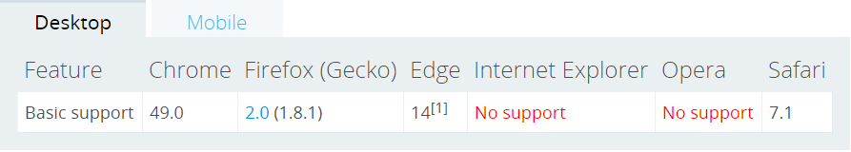
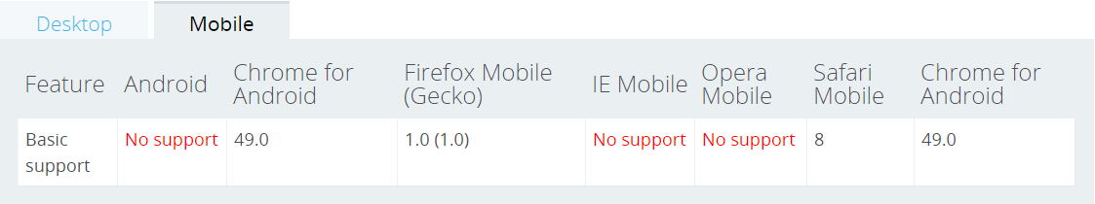
ECMAScript 6 & TypeScript
Browser Compatibility - Destructuring Assignment
copyright 2016 Trainologic LTD

Slide 77
ECMAScript 6 & TypeScript
Intro
Block Scoped Variables
Arrow Functions
Rest Parameters
Template Strings
Default Parameters
Computed Properties
Destructuring Assignment
for...of
for…of
copyright 2016 Trainologic LTD

Slide 78
ECMAScript 6 & TypeScript
for...of
Creates a loop iterating over all values of an iterable object
  Iterable: Array, Map, Set, String, TypedArray, arguments
Each iteration invokes a custom iteration hook (callback)
Syntax:
for (variable of iterable) {
{statement}
}
for ([k, v] of iterable) { // key-value destructuring for Maps
{statement}
}
Note that for…of iterates over the iterable’s values, as opposed to for…in which iterates the iterable’s enumerable properties (keys)
copyright 2016 Trainologic LTD

Slide 79
ECMAScript 6 & TypeScript
Examples - for...of
Arrays and for...in vs. for…of
  var houses = ["Lannister", "Bolton", "Greyjoy", "Arryn", "Baratheon", "Frey"];
  // 0, 1, 2, 3, 4, 5
  for (var house in houses) {
  console.log(house);
  }
  // "Lannister", "Bolton", "Greyjoy", "Arryn", "Baratheon", "Frey"
  for (var house of houses) {
  console.log(house);
  }
copyright 2016 Trainologic LTD

Slide 80
ECMAScript 6 & TypeScript
Examples - for...of
for...of with Maps
  var books = new Map();
  books.set(1, "A Game of Thrones");
  books.set(2, "A Clash of Kings");
  books.set(3, "A Storm of Swords");
  // [1, "A Game of Thrones"], [2, "A Clash of Kings"], [3, "A Storm of Swords"]
  for (var book of books) {
  console.log(book);
  }
  // "A Game of Thrones", "A Clash of Kings", "A Storm of Swords"
  for (var [sequence, name] of books) {
  console.log(name);
  }
copyright 2016 Trainologic LTD

Slide 81
ECMAScript 6 & TypeScript
Examples - for...of
for...of with Maps
  var books = new Map();
  books.set(1, "A Game of Thrones");
  books.set(2, "A Clash of Kings");
  books.set(3, "A Storm of Swords");
  // "A Game of Thrones", "A Clash of Kings", "A Storm of Swords"
  for (var name of books.keys()) {
  console.log(book);
  }
copyright 2016 Trainologic LTD

Slide 82
ECMAScript 6 & TypeScript
for...of & TS
TS transpiles for…of loops into a standard for (…) loop
  var houses = ["Lannister", "Bolton", "Greyjoy", "Arryn", "Baratheon", "Frey"];
  // no special transpiling with for…in loops
  for (var house in houses) {
  console.log(house);
  }
  // transpiled into simple for (…) loop
  for (var _i = 0, houses_1 = houses; _i < houses_1.length; _i++) {
  var house = houses_1[_i];
  console.log(house);
  }
copyright 2016 Trainologic LTD

Slide 83
ECMAScript 6 & TypeScript
for...of & TS
Same for Maps
  var books = new Map();
  books.set(1, "A Game of Thrones");
  books.set(2, "A Clash of Kings");
  books.set(3, "A Storm of Swords");
  for (var _i = 0, books_1 = books; _i < books_1.length; _i++) {
  var book = books_1[_i];
  console.log(book);
  }
copyright 2016 Trainologic LTD

Slide 84
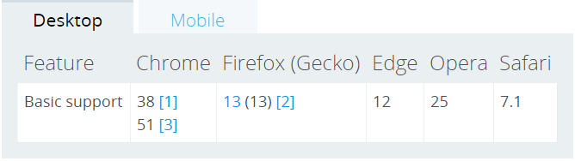
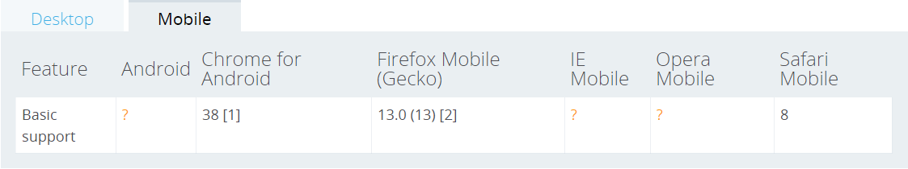
ECMAScript 6 & TypeScript
Browser Compatibility – for…of
copyright 2016 Trainologic LTD

Slide 85

ECMAScript 6 & TypeScript
copyright 2016 Trainologic LTD

